Slide 1




Moradabad Institute of Technology
Major Project Lab
KCS 753
Project Title : Implementing Checkers using IOT
Group Number : P2
Group Members : Kratika (Group leader ) 1900820100062
Dhairya Hans 1900820100037
Dhruv Rastogi 1900820100038
Jatin 1900820100056

Slide 2
About the Project
This project focuses on implementing checkers game on hardware(board) using IOT. This board game will show the possible moves when a player lifts a piece. The moves will be highlighted with the help of LEDs that are embedded in the board.

Slide 3
Implementation
Software : We have developed code for checkers game for backend programming. This has been implemented in C++.
Hardware : We have worked on the configuration of Arduino Uno. We are able to successfully execute the program for controlling LED and the hall sensor.

Slide 4
Key Features
Prediction of moves
Colorful LEDs
Follows Checkers Rules
Portable
Interactive design
Best for beginners
Build logical thinking
Build problem solving skills

Slide 5
Demonstration of Project
In the upcoming slides, the working of the project will be demonstrated with the help of Images.
These Images have been clicked during the Actual Game played between 2 players.
Note :
Player 1 has chosen White Color and Player 2 has chosen Black

Slide 6
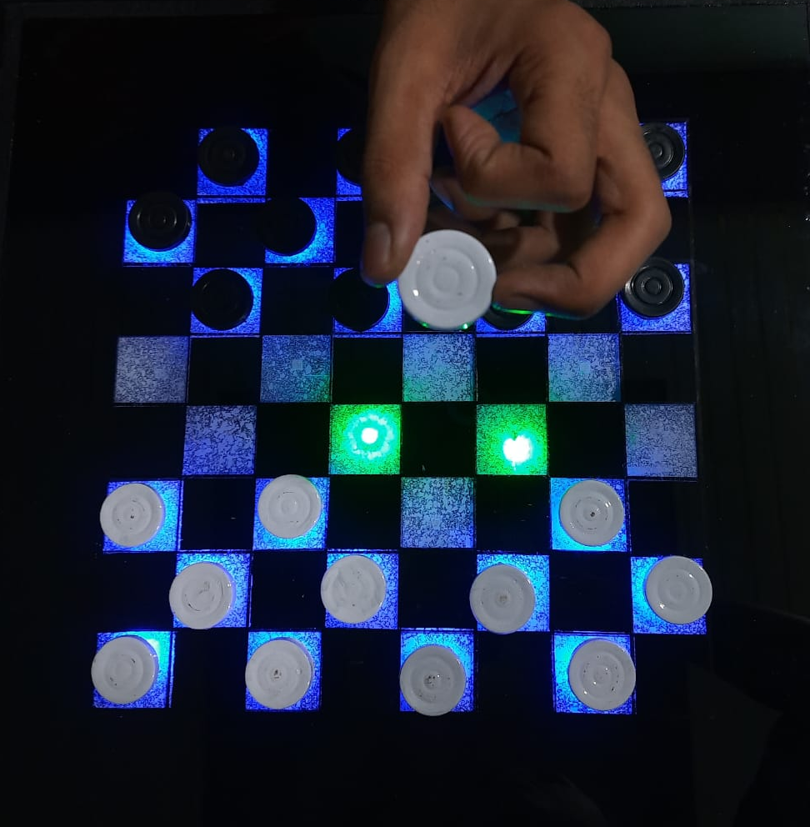
Demonstration of Project
1
2
3
Initially, its turn of Player 1. The board glows in Blue color.
Player 1 lifts a piece.
Possible moves are shown in Green color.
4
5
6
7
8

Slide 7
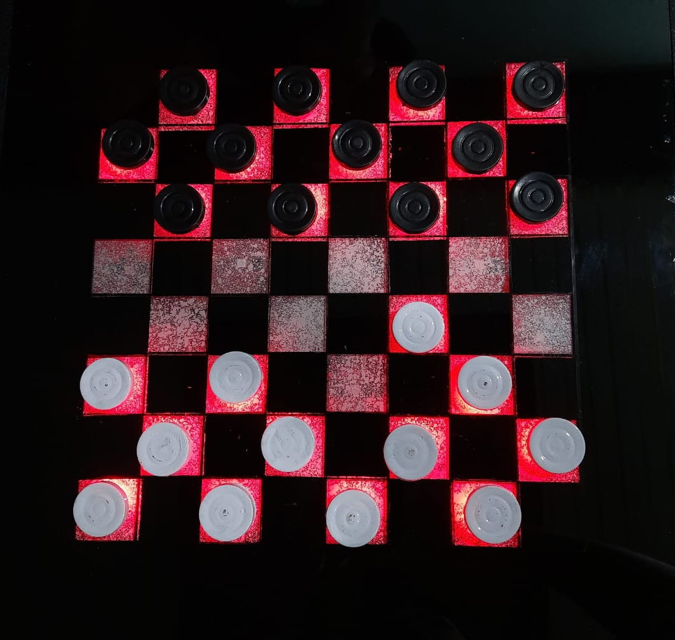
Demonstration of Project
1
2
3
Player 1 has played.
Now,
Its turn of Player 2. The board glows in Red color.
4
5
6
7
8

Slide 8
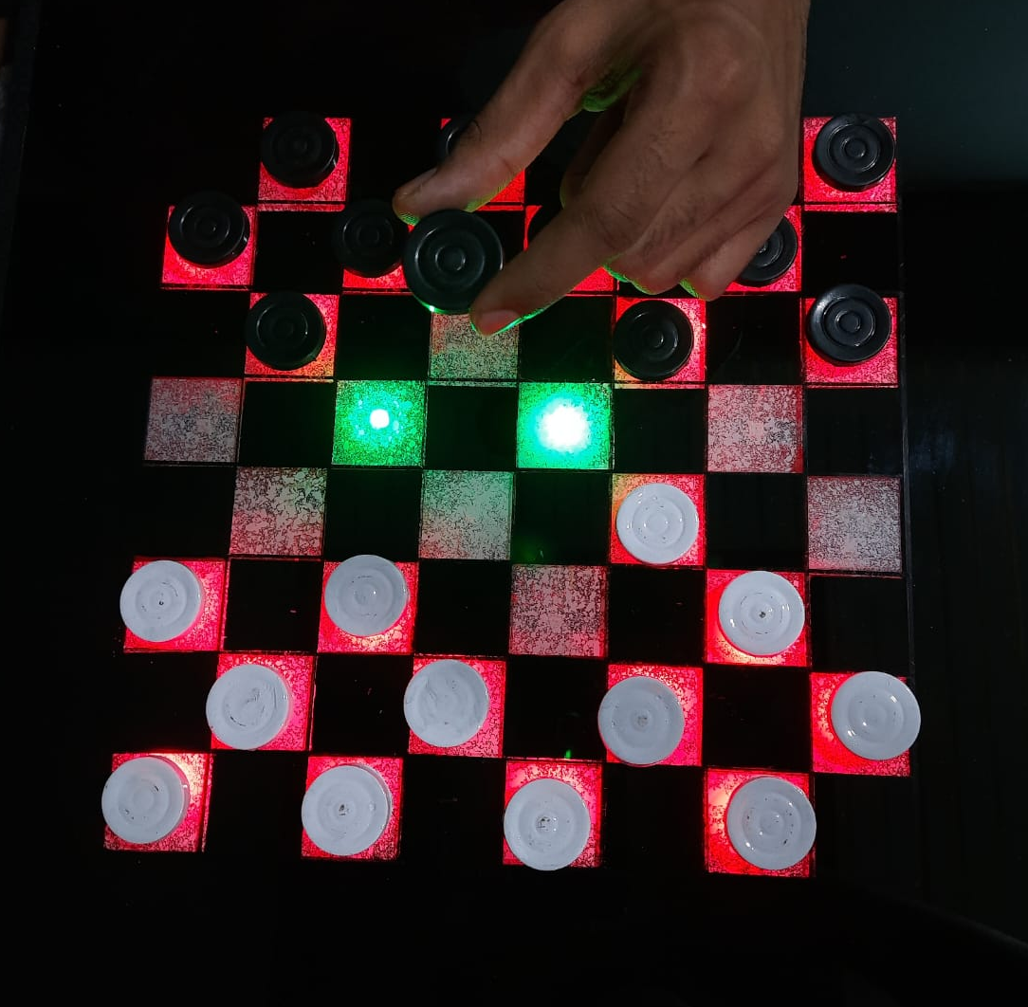
Demonstration of Project
1
2
3
Player 2 lifts a piece.
Possible moves are shown in Green color.
4
5
6
7
8

Slide 9
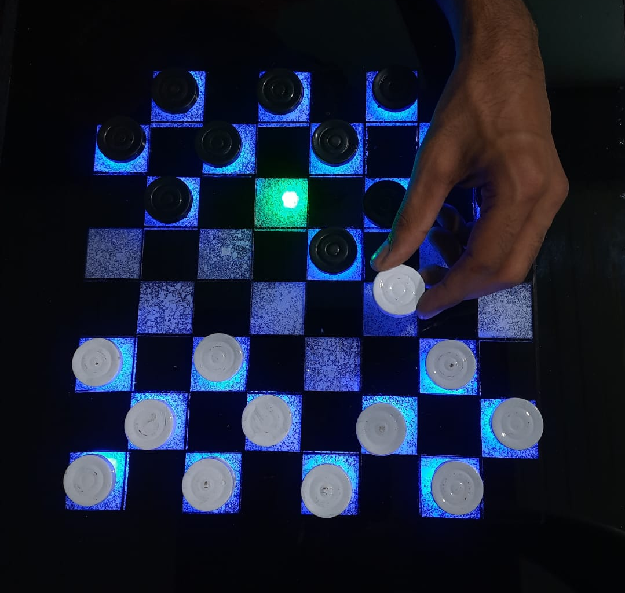
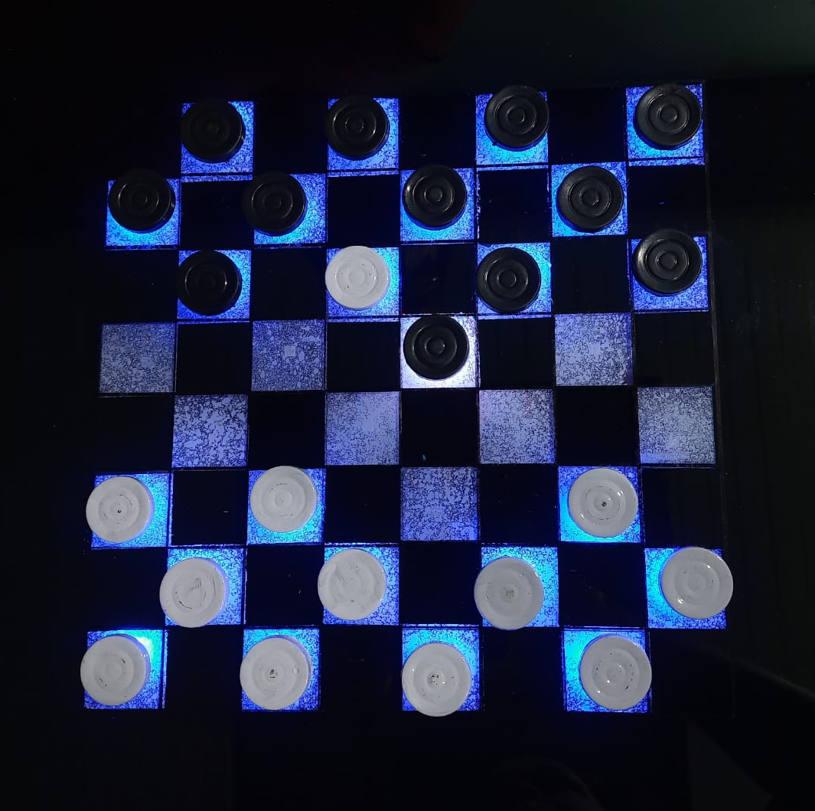
Demonstration of Project
1
2
3
4
5
6
7
Player 1 lifts a piece.
Possible moves are shown in Green color and the captured Token is shown using White color
8

Slide 10
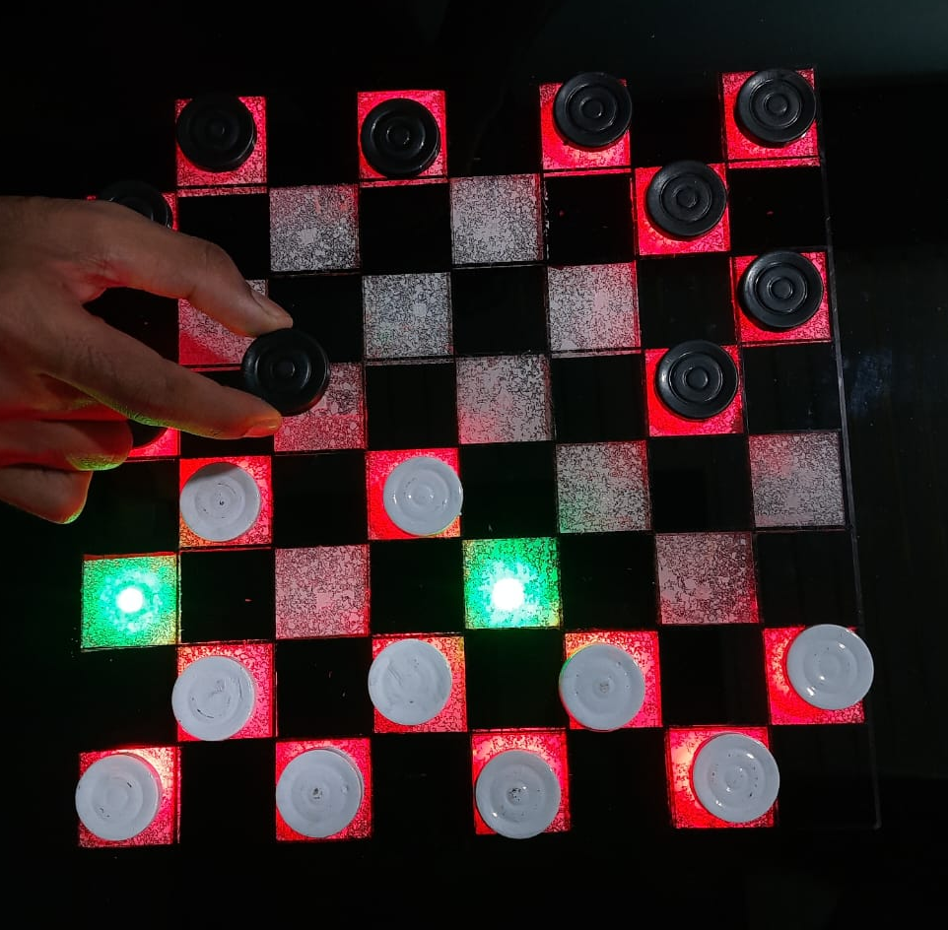
Demonstration of Project
1
2
3
Player 2 lifts a piece.
Possible moves are shown in Green color .
If a player has choice between jump on an empty box or capture a token,
In such case board will give priority on capturing the token. Hence showing the best possible move.
4
5
6
7
8

Slide 11
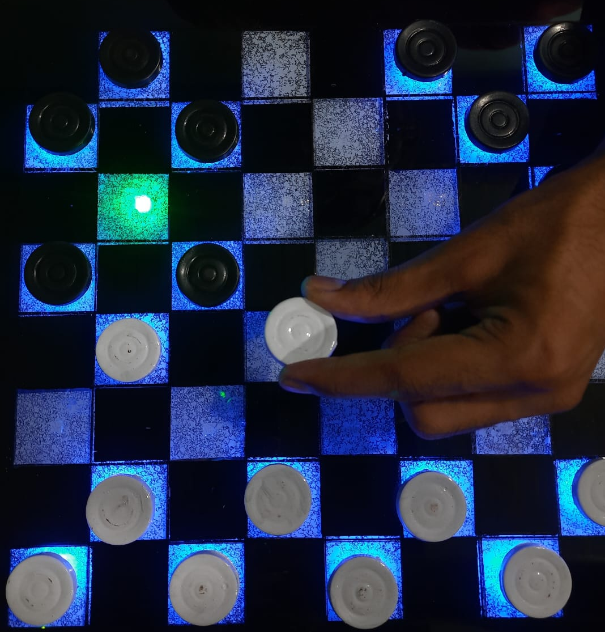
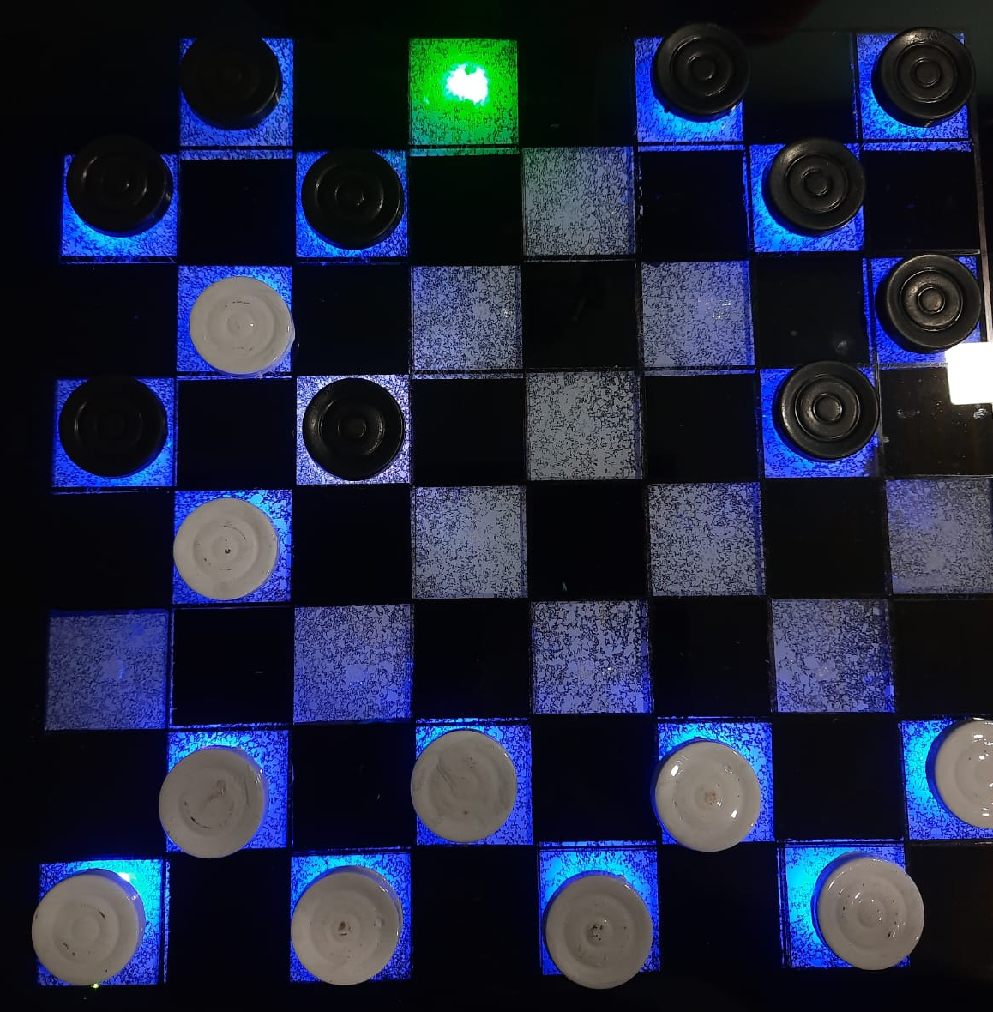
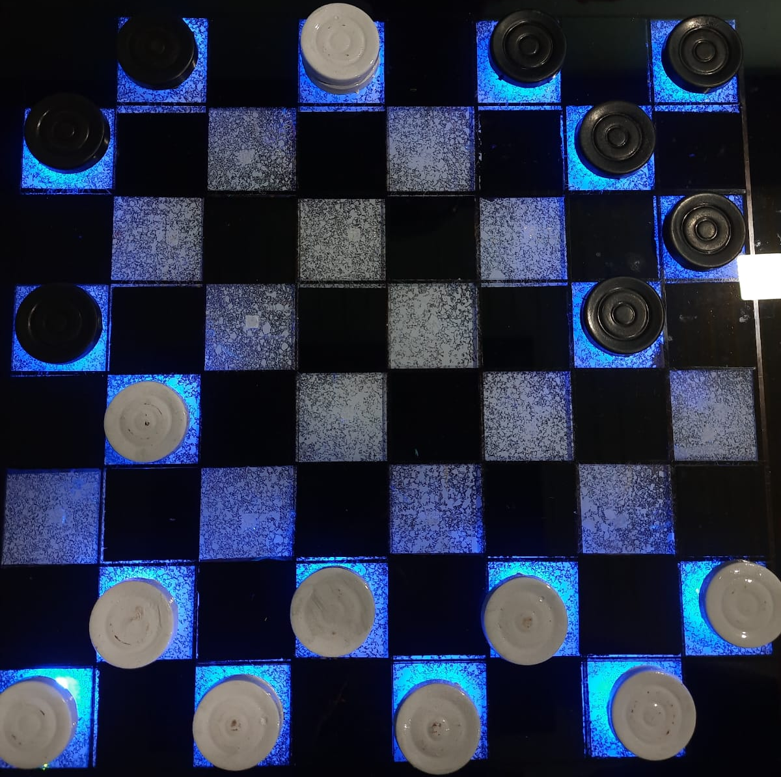
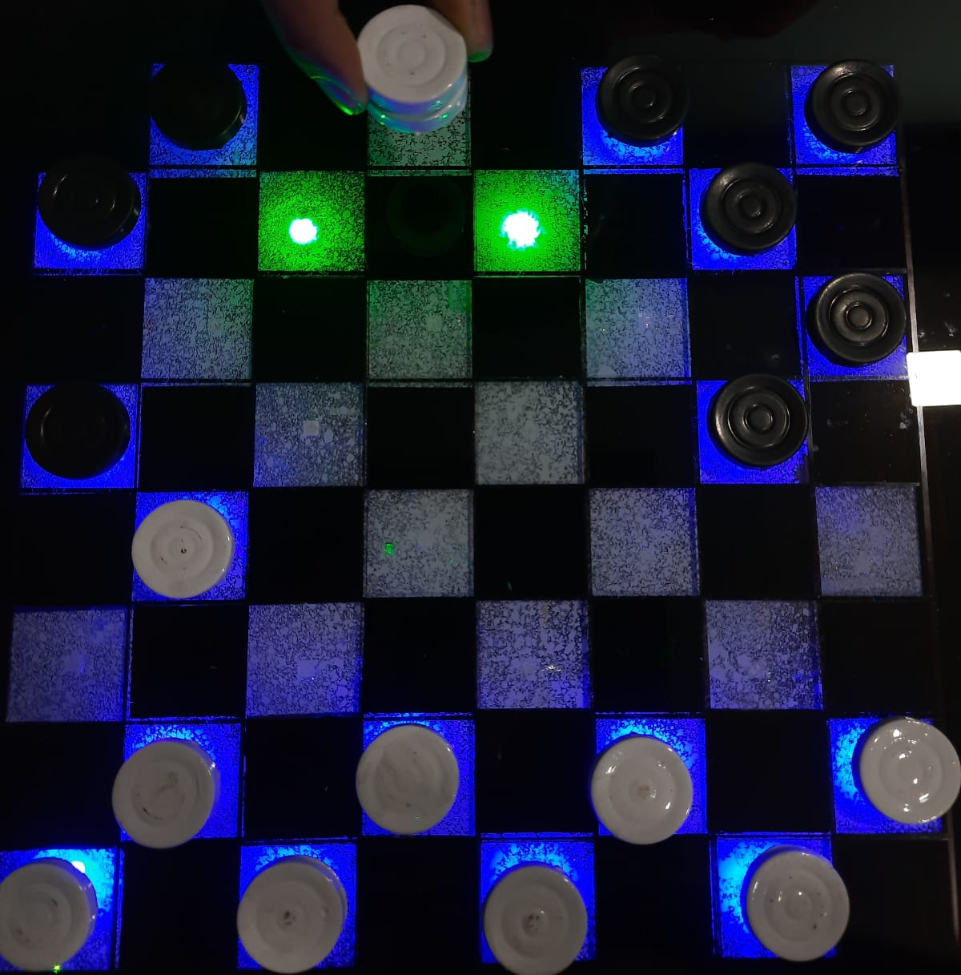
Demonstration of Project
1
2
3
4
5
6
Player 1 attempts to capture tokens and make KING
Captures first Token of opponent
Captures another Token and reaches to the end of board
Gets another chance on becoming King while capturing opponent’s Tokens
7
8

Slide 12
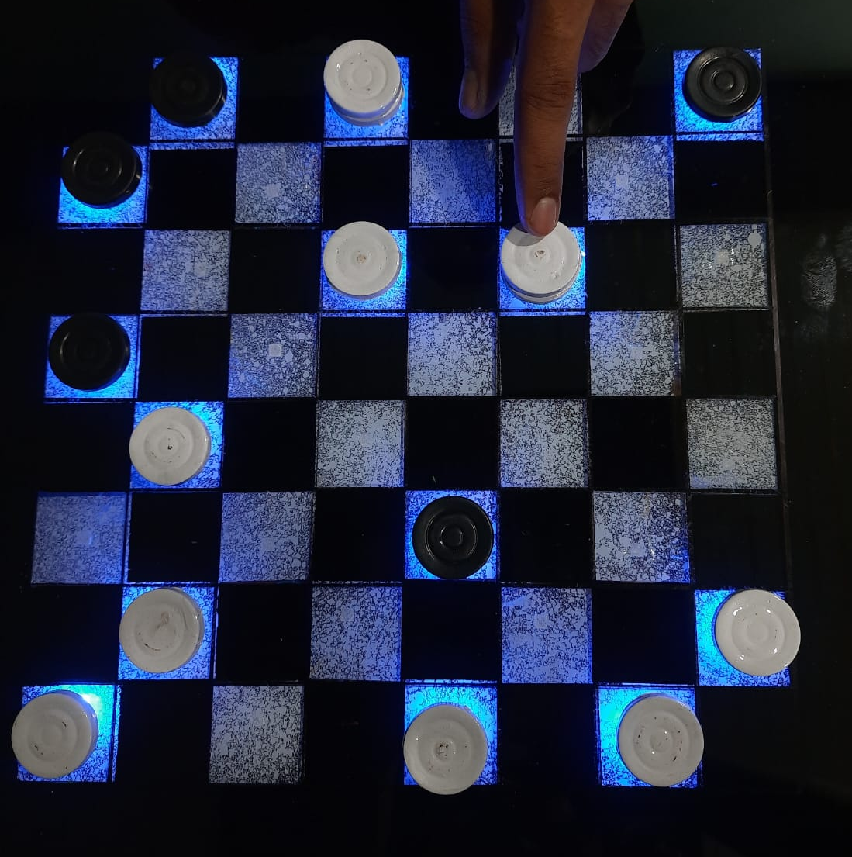
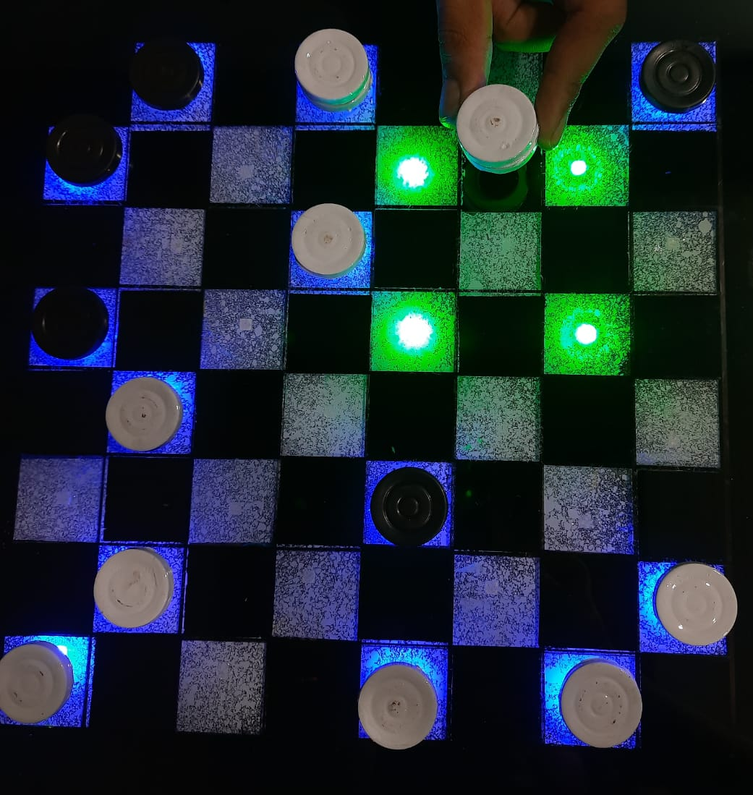
Demonstration of Project
1
2
3
4
5
6
7
Player 1 lifts the KING Token.
Possible moves are shown in Green color
8

Slide 13
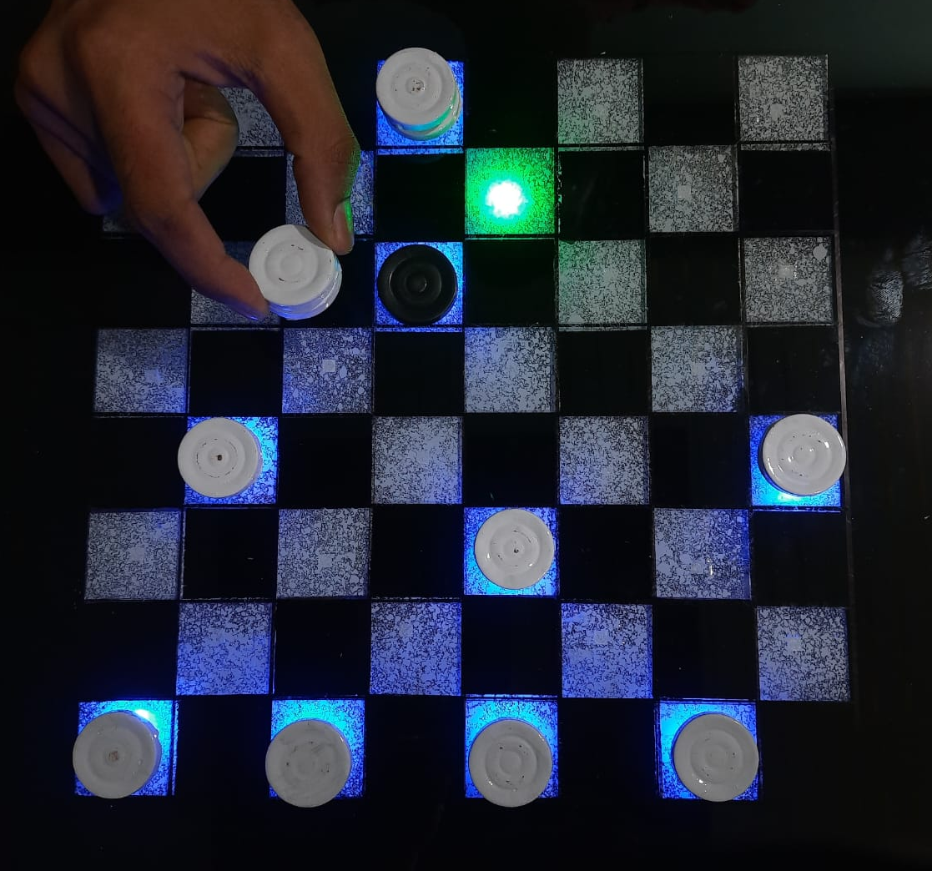
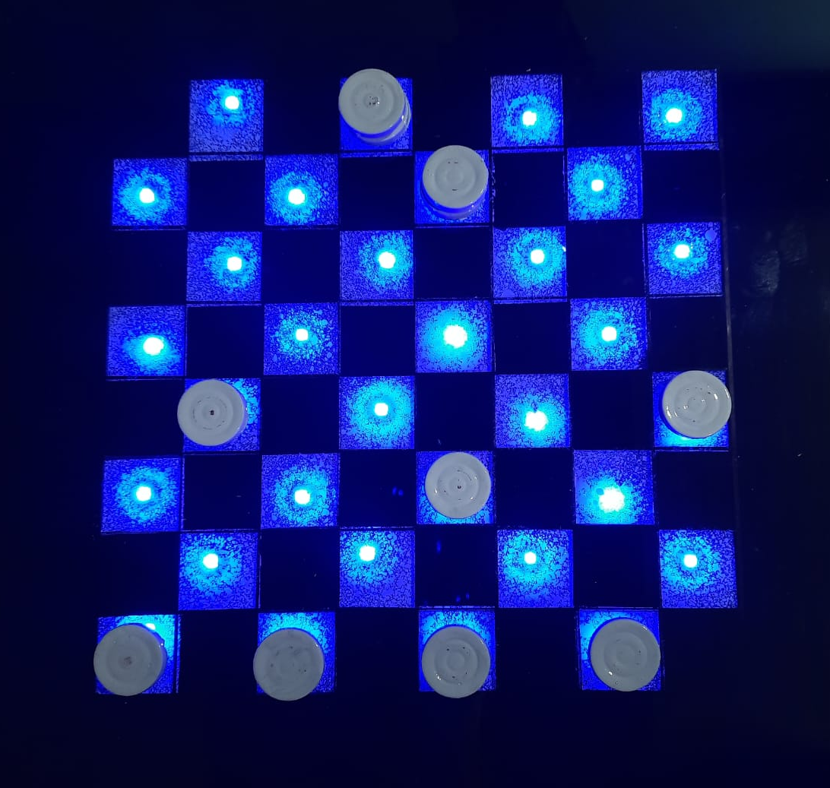
Demonstration of Project
1
2
3
4
5
6
7
Player 1 captures the last token and WINS
At the end of the game, all the LEDs on the board glows in winner’s allotted color.
8

Slide 14
Thank You

